Slide 1
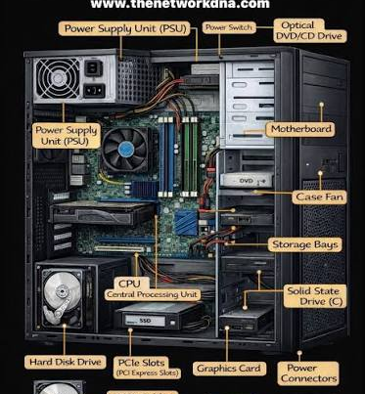
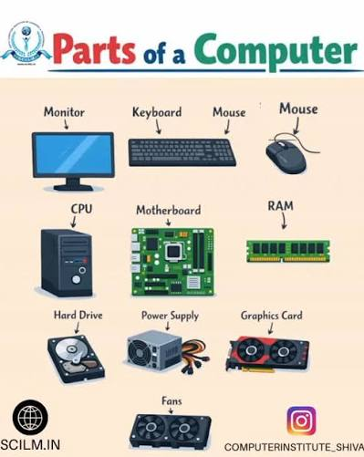
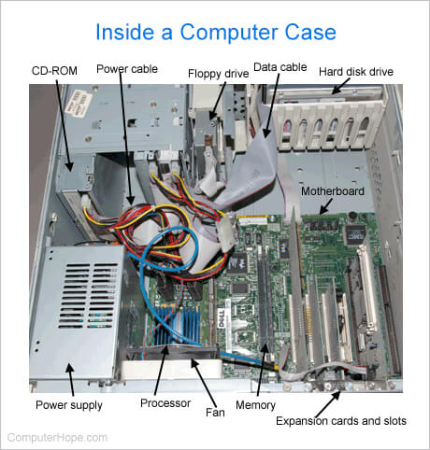
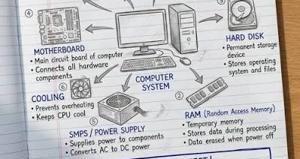
Computer & Systems Glossary Identification Assignment
By: Austin D'Costa

Slide 2
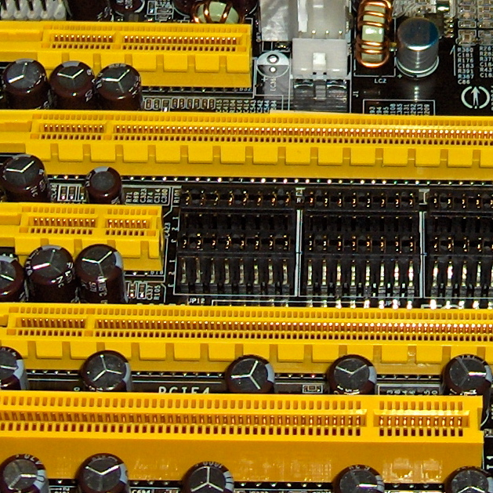
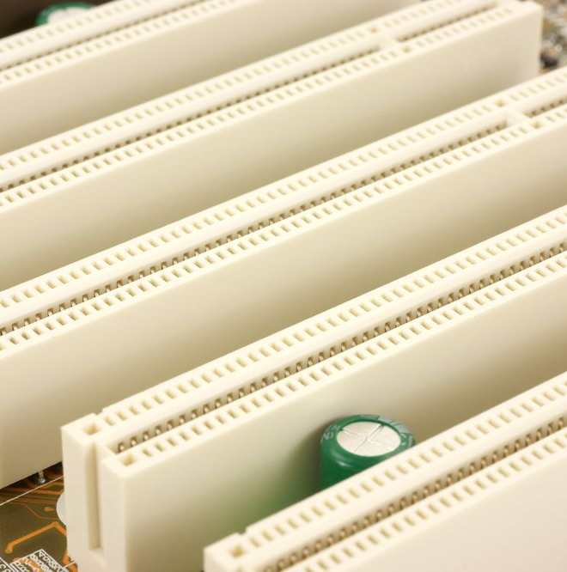
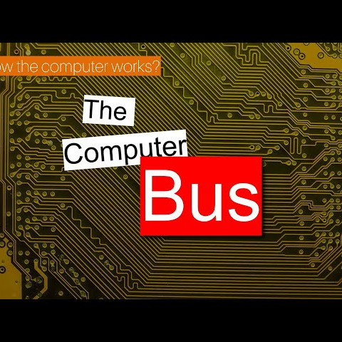
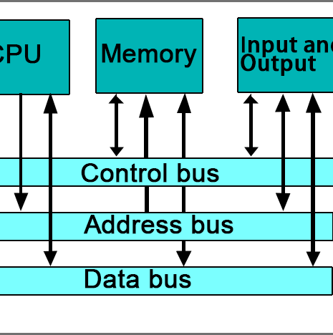
Term 1 - Bus
A Bus is a single shared pathway in computers that distribute data or signials to multiple components. An Example of this can be somewhat simmilar to a highway, the cars, trucks, motorbikes can all be represented as either data or signials, and the roads can be represented as wires that transfer them to their destination.
There are plenty of different bus they can either be:
  Address Bus
  Data Bus
  Control Bus

Slide 3
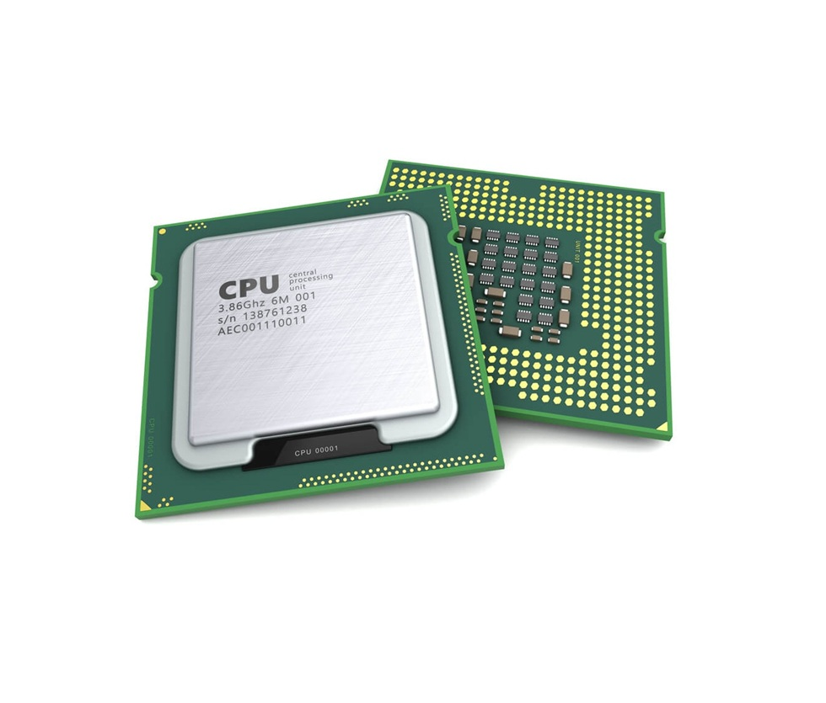
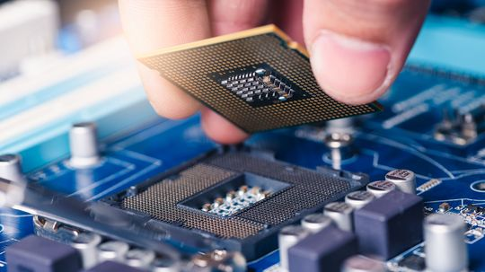
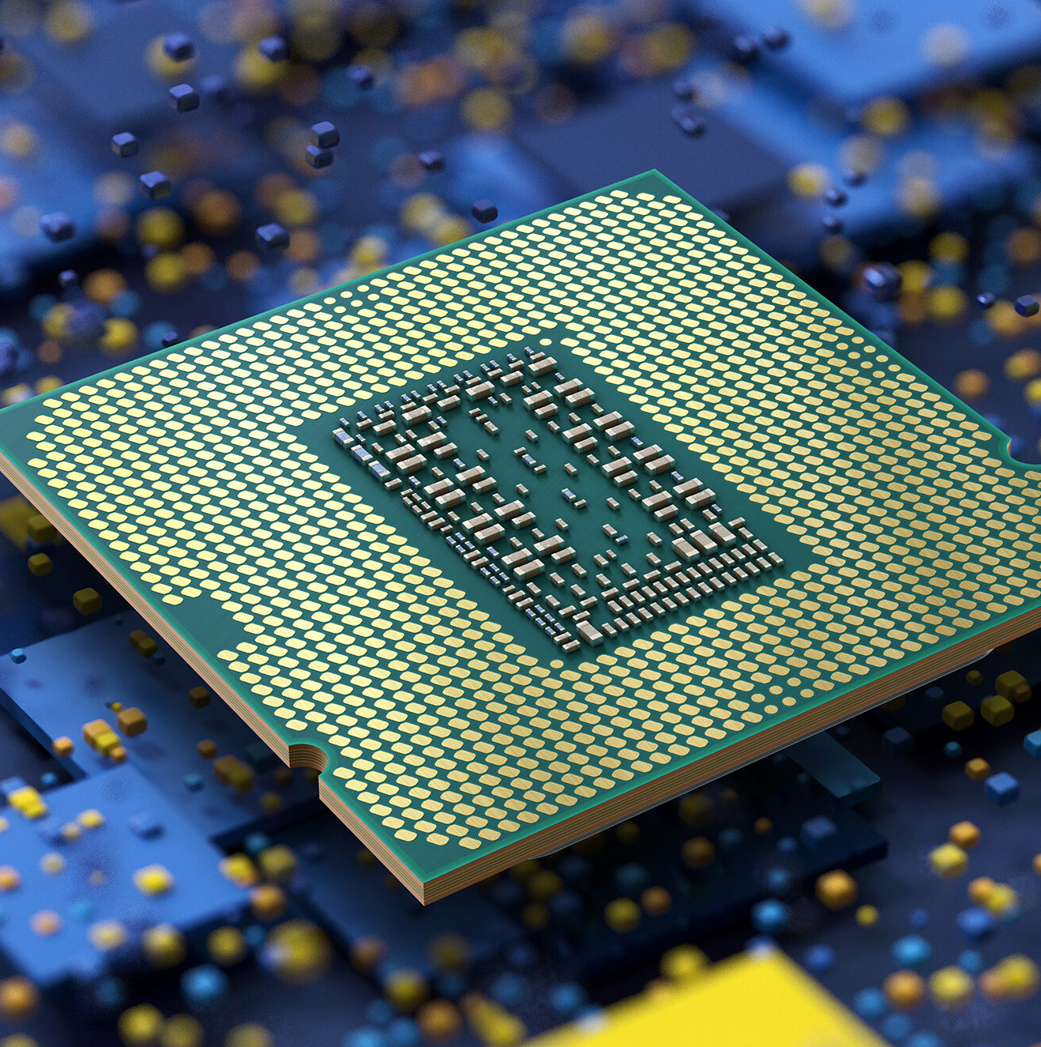
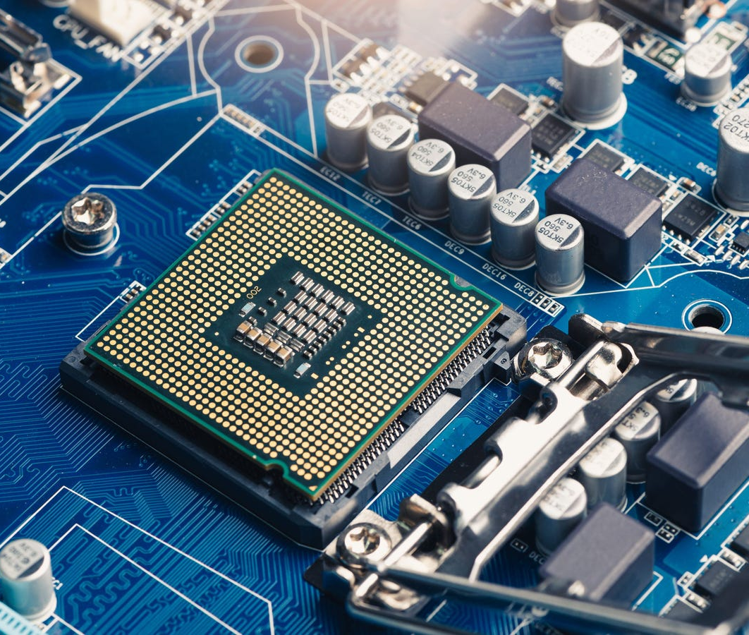
Term 2 – CPU (Central Processing Unit)
The term CPU in its long word for is known as the "Central Processing Unit". This part in a computer is one of its most important parts. Just like humans need brains to operate, computers do too. The CPU is the brains of a computer where is calculates calculations. This makes a computer one of the core elements in a computer. Inside ther is a ALU which is the reason why the CPU is able to calculate arthermetic operations and logical operations. Moreover, the CU (Control Unit) decodes information given by the instruction and execute the command given. When on large machines multiple CPU's are installed, on a small computer only one is installed.

Slide 4
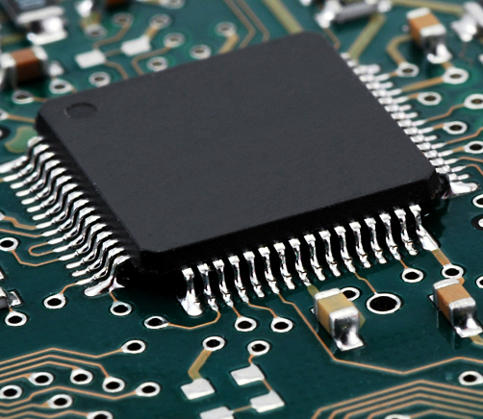
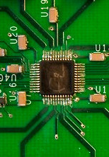
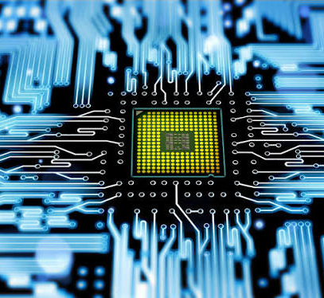
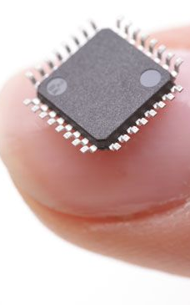
Term 3 – Chip (IC)
A chip or IC ( Intergrated Circuit ) is a small but mighty highly efficent semiconcuctor. The main purpose of this component is that it stores a variety of components such as translators resistors and compacitors. This is a modern component that is use in every day electronics, such as your phones, laptops, tvs etc. The function of this component is that it processes data, amplifies signials and stores information. While, this tool in the computer is efficent one may think they are highly expensive. In reality are cheap and more reliable than other components.

Slide 5

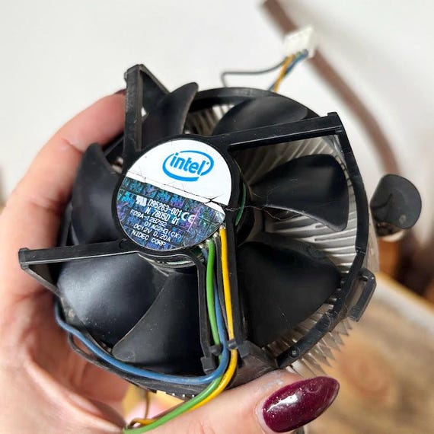
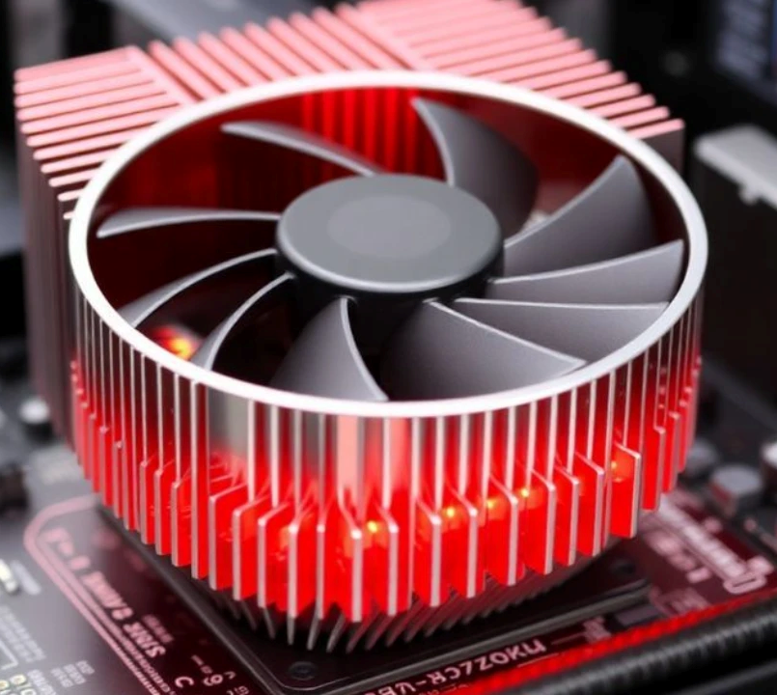
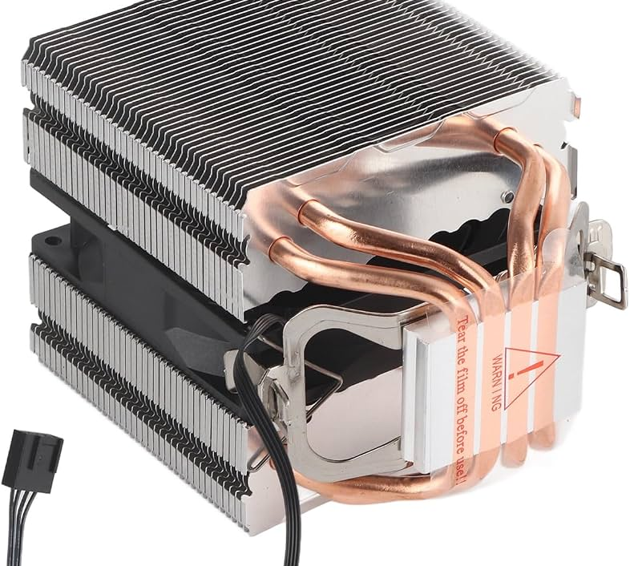
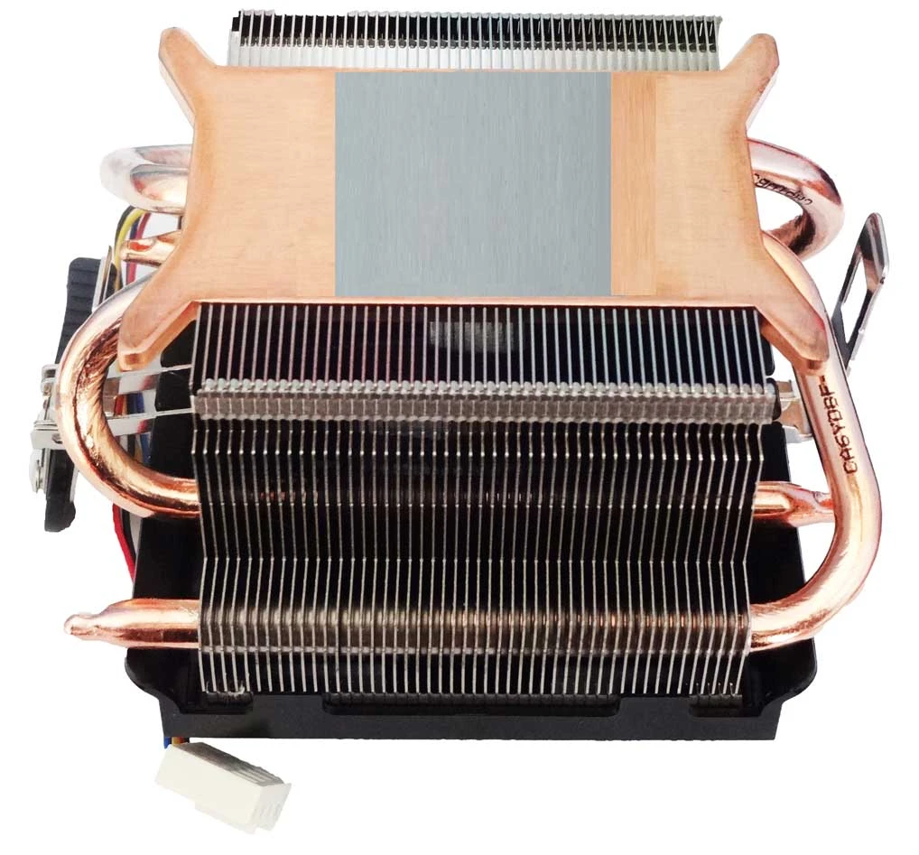
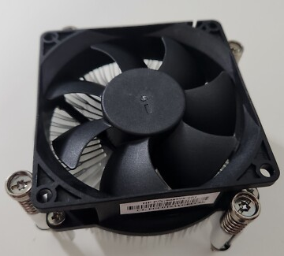
Term 4 – Chip Coolers
Heat Sink (Passive chip cooler) - If you have an electronic that over heats itself when being used. This can be a real bothersome managing this issue, and could damage your device. The solution to this problem is none other that a "Heat Sink". A heat sink is a component that helps with overheating devices and its thermal issues. This can come from CPU, GPU's and translators. Overall, this can help reduce performance or damage. These pieces are built with either aluminum or copper to ensue and maintain heat transfers.
Fan (Active chip Cooler) – An active chip cooler is a device that is attached to the mother board that has both a built in copper or aluminum that is attached with a powered electric fan on the microchip. In turn, this helps cool down the temperature of computer parts. The metal on the chip sucks in the heat within the computer this can be similar to a sponge absorbing any fluids. The fan on the micro controller blows cooling air across the hot metal, so there is no heat in the component.

Slide 6
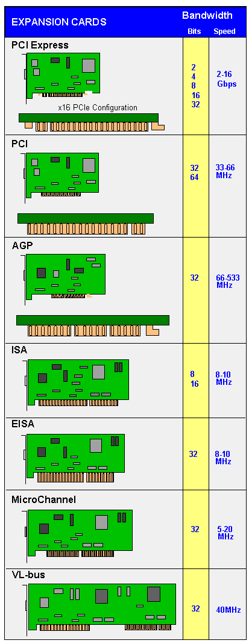
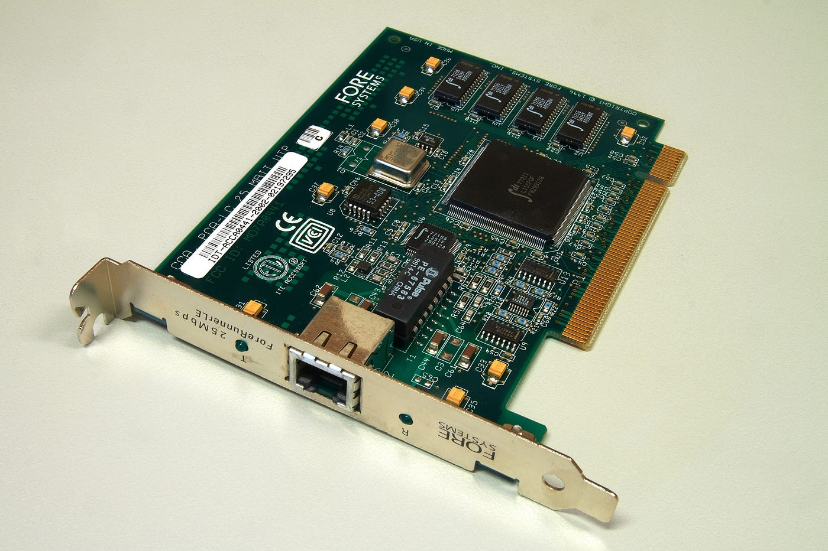
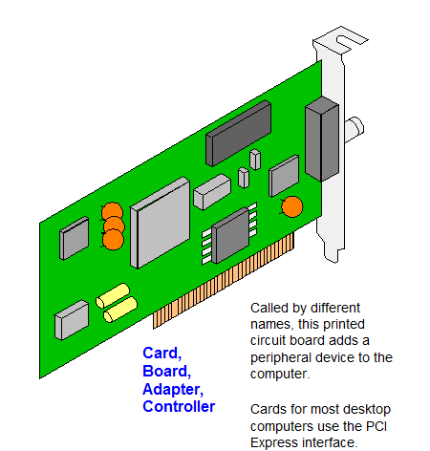
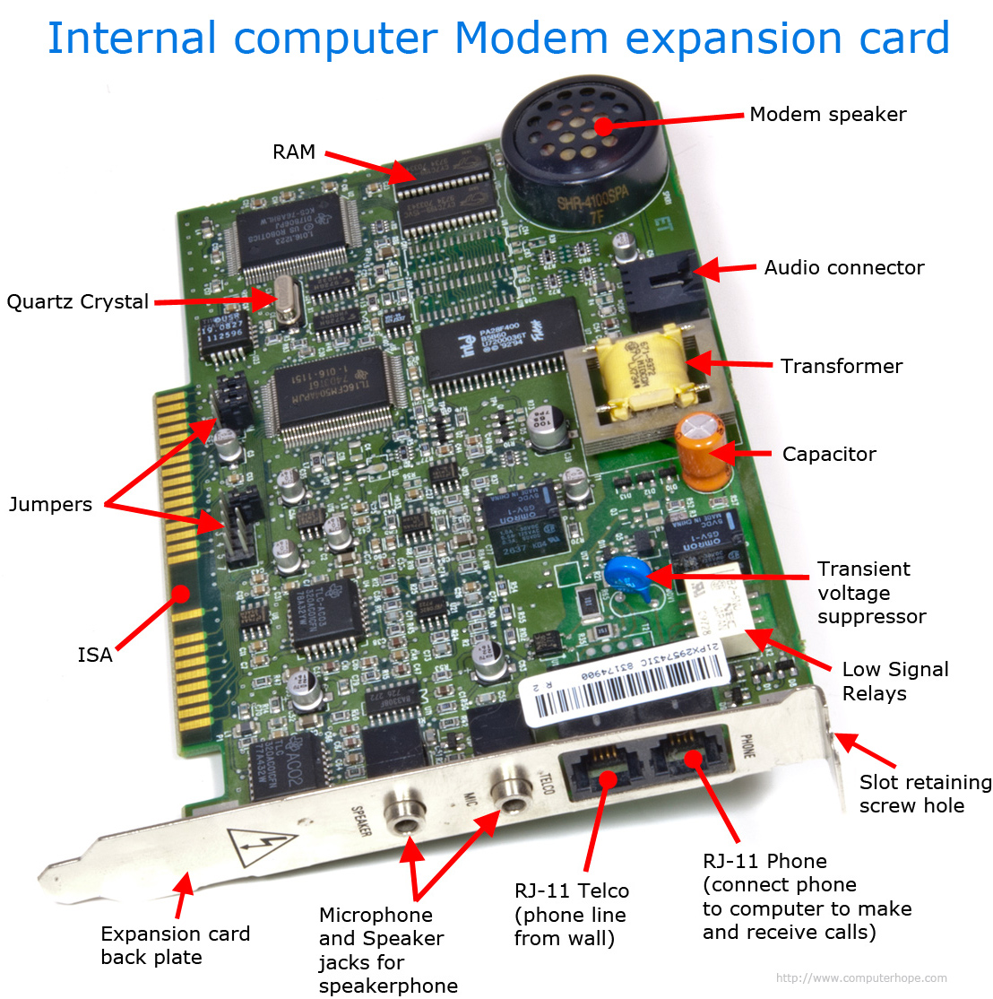
Term 5 - Expansion Cards
An Expansion card is a hardware component which is an add on card that you can put into your expansion slots for more functionality within your device. Electronics like, Pcs, Old gaming devices, Network servers and Industrial Systems all use and expansion card. There are many graphic cards with all unique functions that match your requirement. Some include, graphics card, sound cards, Wi-Fi cards and storage controller are all types of expansion cards. If you have expansion cards you could use it to better optimize your gaming sessions, graphic designing or if you want to be connected to the internet, a wifi card could come in handy.

Slide 7
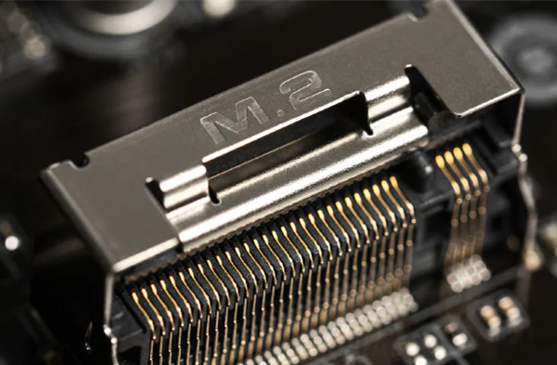
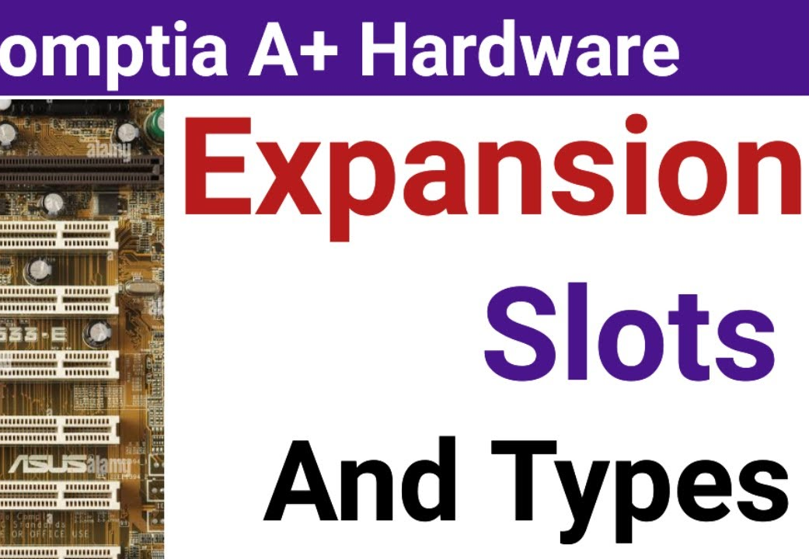
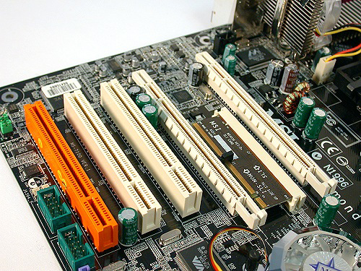
Term 6 - Expansion Slots
An expansion slot is a socket on the computer of the motherboard. It allows you to attach and install components that were not previously there. These slots when used are able to enhance your functionality to your system. There are several slots that are known, those being - peripheral component interconnect (PCI), PCI express (PCIe), accelerated graphics port (AGP), and industry standard architecture (ISA). People who use these slots are gamers, video editors, IT professionals and office workers. One uses so they don’t have any lag when playing, another for lag free audio, handle massive internet traffic and hardrives or for Wi-Fi cards or connection cards.

Slide 8

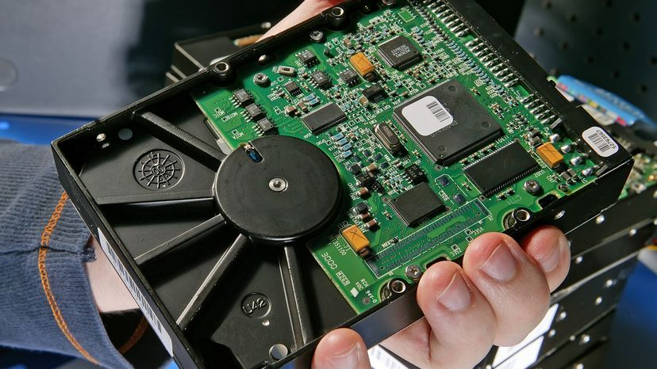
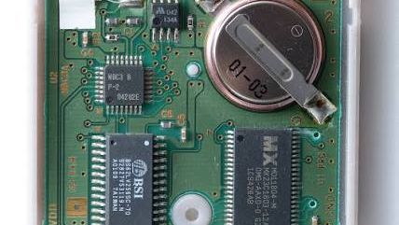
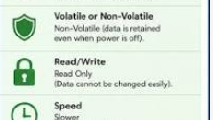
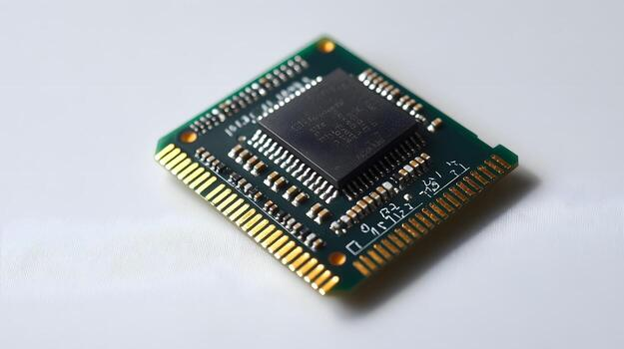
Term 7a – Memory (ROM)
ROM is known as (Read On Memory), this is a type of memory where there is stored permanent instructions and data stored into the device for start up. As the name suggest Rom can only read from, not written to. This type of data cannot be changed, even if you turn off. The memory will still be retained to perform basic functions such as, initializing hardware and loading to operating systems. They remain unchanged even after the computer has been programed. ROM operates using integrated circuits called "memory cells." When current passes through these transistors, they create a magnetic field which stores the data from the memory cell until it is cleared by another signal being sent through the transistor.

Slide 9
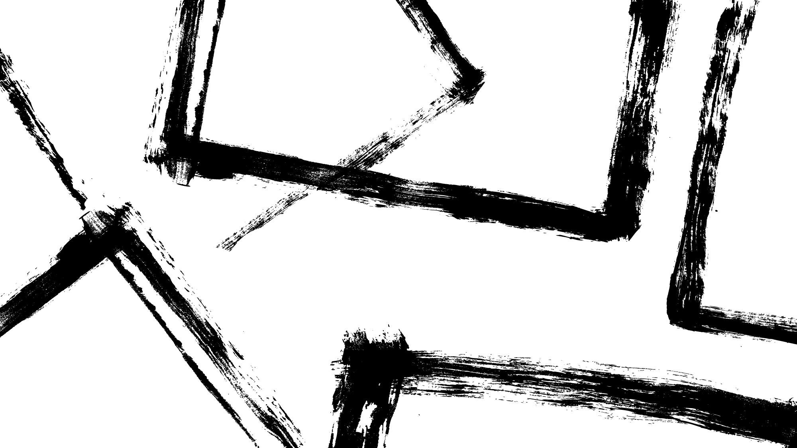
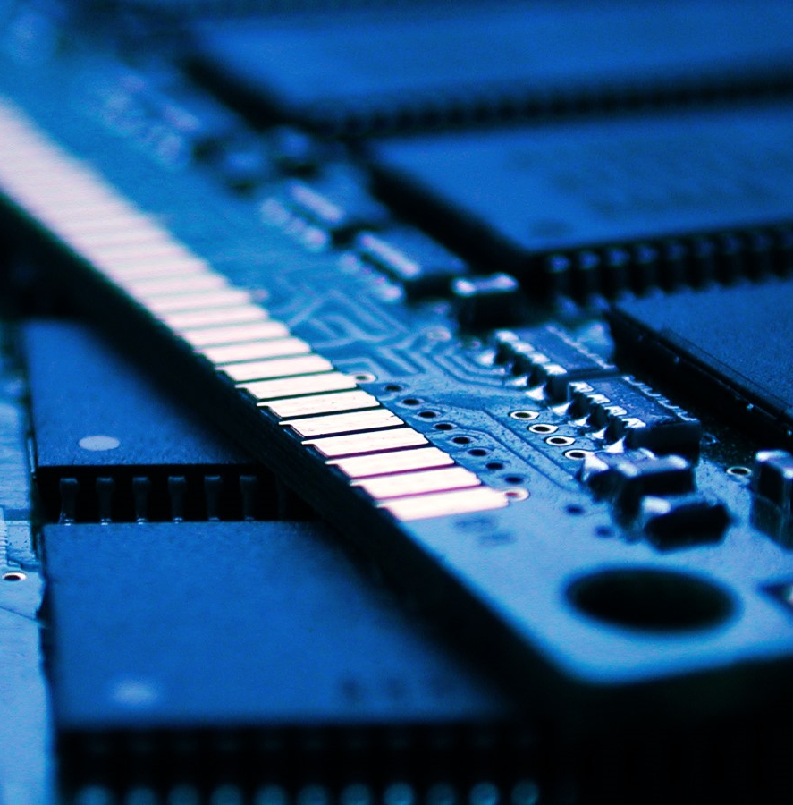
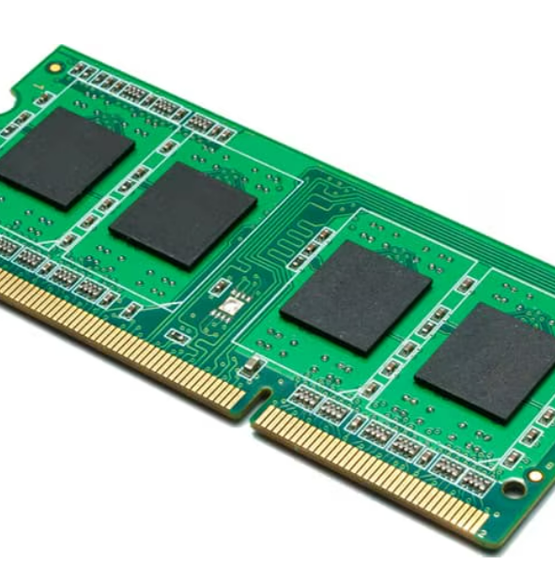
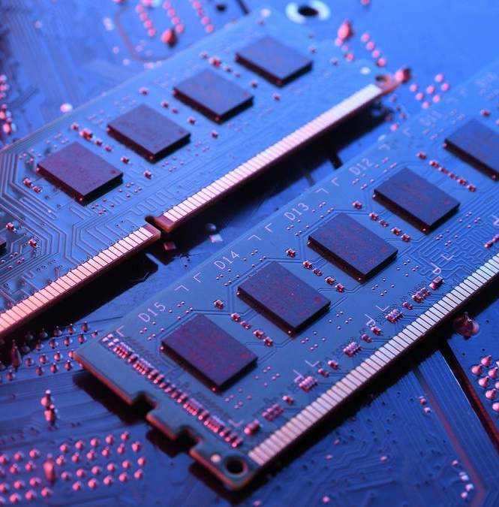
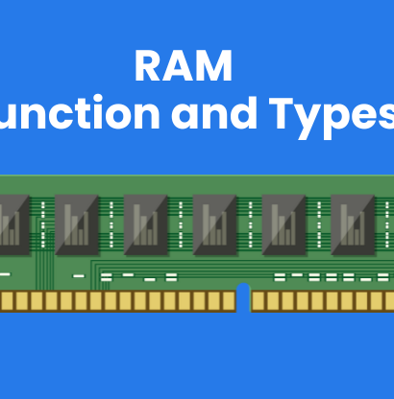
Term 7b – Memory (RAM)​
RAM is defined as an acronym known as (Random Access Memory). The function of ram is required in PC’s to store data where inside, your processor can run applications and open files. RAM is usually a rectangular circuit board with memory chips called memory modules attached to them, which are import . The reason for this statement is that they must work in order for the user to have a better experience. RAM is required for gaming ,streaming a movie on your computer and loading data, the quicker RAM is the better. If it is slow than you are just going to be looking at a cursor entirely. It is similar to if one asked you to gather up a bunch of tennis balls left on a court, but there were more than you could easily carry in your hands. You would have to start shuffling the balls around and stashing them in pockets or in your arms in order to move them all at once.

Slide 10
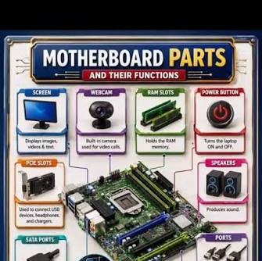
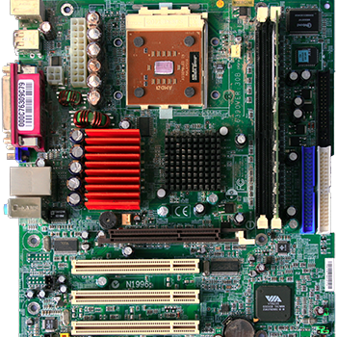
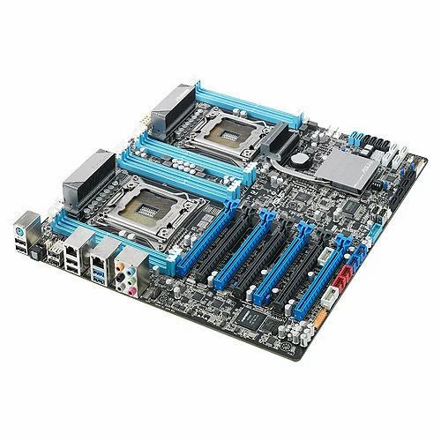
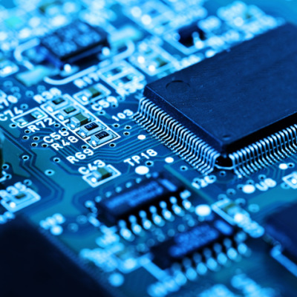
Term 8– Motherboard
A motherboard is the most important, iconic circuit board in any computer system. There are internal parts in the mother board such as, graphics card, memory processors. There are several parts on the motherboard such as CPU, GPU, RAM, ROM. These parts are connected to the motherboard because, when they are connected the components cand do what the user is asking. The features that the motherboard has is FireWire, audio processors or Ethernet Ports.

Slide 11
Term 9 – Input Peripherals & Output Peripherals​
Input Peripherals: An Input Peripheral is to send data, instruction and commands from the user into the computer system. My example of an input Peripheral is a keyboard. The words typed by the user known as key caps are more than just keys for typing. They are a switch that detects when a key is pressed. This device is used by office workers, students, gamers etc. One can use this to write emails, essays, text on discord, search something up. If one does not have this, they will not be able to type commands in and produce results on their device.
Output : The Main Job Of an Output Peripherals is to receive instructions/ data from ther computer and give a form of a solution where humans/ user can understand. My example of a Peripheral output is a printer. The input Peripheral takes in my commands of what I want it to print and condenses it into its own language later writing it in a way I understand. I can ask for ink, no ink, a picture, a essay, a document, scanning etc all thanks to the printing command from the input Peripheral.

Slide 12
Term 10 - Power Supply

Slide 13
Term 11 – Storage (Hard Drive & Flash drive)

Slide 14
Term 12 – Sensors
(Temperature Sensor) – A temperature sensor is a tool used to measure the level of temperature be it hot or cold in an object. It all depends on the internal resistance; cooler environment have low resistance whereas hotter area have higher resistance. We have to use a thermometer or thermoreceptors. This tools converts it into Celsius or Fahrenheit.
(Light Sensor) - A Light Sensor or LDR is a variable resistor whose resistance depends on the amount of light falling from the surface. LDR change accordingly to the intensity of light falling on its surface. As the intensity of light is falling or the LDR increases its resistance decreases and if it were the opposite LDR decreases and resistance increases. LDR exhibit all properties of semiconductors one such property is photoconductivity.
(Sound Sensor) – A sound sensor is a device that converts sound waves into electrical signals that can be used to detect and measure the frequency, and the duration of soundwaves. The sound sensor works ins a way similar to an ear. They use a microphone within the sensor that captures sound signals and converts them into an output signal on a microcontroller. IT combines it with a microphone processing circuitry and turns sound waves into electrical signals.
(Distance Sensor) – A distance sensor is also known as an Ultrasonic Sensor, it uses waves that are either ultrasonic or ultrasound to detect the obstacles in its robotic application. Ultrasonic sensors are not audible to human ears since a human can only hear frequency of 20Hz to 20KHz. On the other hand ultrasonic sensors go above 40KHz. The ultra sonic transmits waves and waits to reflect back which helps determine the distance between the sensor and the object.
(Motion Sensor) – A motion sensor is a electronic device that detects physical movement and is used in area by monitoring heat, light or sound waves. This can be trigged by an object person animal etc. This is most commonly found itn home security systems for the homeowners who thinks there can be an intrusion. Motion sensors act as a crucial layer of protection against intruders, not permitted access and a sense of safety.

